Slide 1

Save Our Sisters
“चकमन्न रात, सुनसान सडक, एक्ली केटी..
मौक हैन जिमेवारी सम्झानुहोस् | ”
#asianhack2018

Slide 2
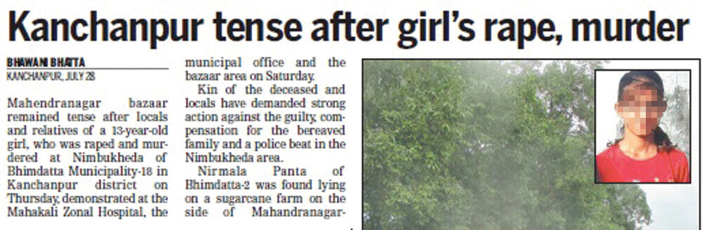

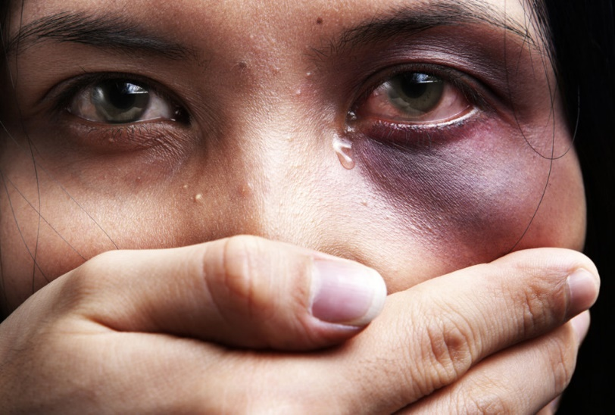
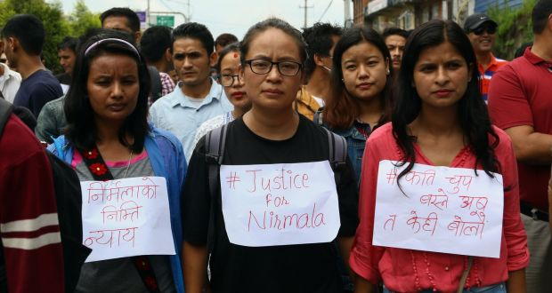
Current Problems

Slide 3
Graph Report

Slide 4
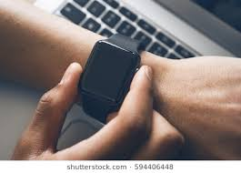


Proposed Solution
Request
v
How it works?
GPS with Network Adapter
CONTROL ROOM
CARE MEMBERS
Response
Redirect

Slide 5

Our Challenges
Lengthy KYC Process
(Know Your Customer)
Unwanted Vibration

Slide 6
Future Enhancement
Fingerprint authentication
Data Analysis
Location
re-tracking in every 60 seconds
Siren system

Slide 7

Demo

Slide 9


